Slide 1

Retail Revenue Analysis for Leadership Decision Making
Optimizing Performance Across Products, Demographics, and Territories
PRESENTED BY GURU VIGNESH | SEPTEMBER 2026
DATA SOURCE: RETAIL_TRANSACTIONS_Q3

Slide 2

Standardizing 12,000+ Transactions Ensures Analytical Integrity Across KPIs
12,000
20
100%
Verified
TOTAL TRANSACTIONS
CORE DATA FIELDS
RECORD COMPLETION
DATA STATUS
Transaction Date
Buyer Name
Location
Product Code / Cate
Quantity Purchased
Gender
Standardization Process
2024-01-13
Allen Santos
San Antonio
Pro02
284
Other
1
Schema Alignment
2024-05-09
Brenda Shaw
San Jose
Pro05
90
Male
Unified headers for dates, locations, and buyer demographics to support longitudinal analysis.
2024-05-20
Robert Hernandez
Philadelphia
Pro04
475
Female
2
Categorical Mapping
2024-04-28
Alexander Smith
San Antonio
Pro02
299
Male
Mapped internal SKU codes to Brand names and tiered pricing structures.
2024-02-07
Mary Rodriguez
San Jose
Pro09
327
Other
2024-06-30
Clinton Haynes
Philadelphia
Pro04
383
Female
3
Deduplication
Removed transaction overlaps and validated unique order IDs across 12 monthly batches.
2024-03-26
Jamie Steele
San Antonio
Pro07
272
Other
2024-07-27
David Hunt
San Jose
Pro10
270
Male
2024-06-22
Robert Hernandez
Philadelphia
Pro06
201
Other
Page 1

Slide 3

XLOOKUP Logic Maps 10 Core SKUs to Brands and Tiered Pricing
10
7
$11 - $60
Verified
UNIQUE PRODUCT CODES
MAJOR BRANDS
PRICE RANGE
PRICE CATALOG
Master Product Catalog
Lookup Implementation
Product Code
Biscuit Brand
Cost Price
Unit Price
Pro01
Good Day
$10
$11
=XLOOKUP([@[Product Code]], Master[SKU], Master[Brand])
Pro02
Britannia
$18
$22
Links transaction lines to the master catalog to ensure consistent naming and reporting across all 12,000 records.
Pro03
Sunfeast
$3
$5
Pro04
Malkist
$10
$14
=XLOOKUP([@[Product Code]], Master[SKU], Master[Unit Price])
Pro05
Oreo
$14
$28
Pro06
Parle
$20
$28
Automates pricing application, reducing manual entry errors and maintaining margin calculation accuracy.
Pro07
Tiger
$18
$24
Pro08
Marie Gold
$18
$30
Key Benefit: By centralizing the product master, we can update prices or costs globally without modifying historical transaction data, allowing for dynamic "What-If" analysis.
Page 2

Slide 4

Calculated Fields Transform Raw Volume into Profitability Intelligence
$61.6M
$26.8M
43.5%
6 KPIs
TOTAL REVENUE
TOTAL PROFIT
AVG PROFIT MARGIN
AUTOMATED METRICS
Total Revenue
Total Cost
Profit
Profit Margin %
Age of buyer
Age Bucket
A. Total Revenue
=[@[Unit Price]]*[@[Quantity Purchased]]
$6,248
$5,112
$1,136
18%
60
59-68
$2,520
$1,260
$1,260
50%
81
69+
B. Total Cost
$6,650
$4,750
$1,900
29%
72
69+
=[@Cost]*[@[Quantity Purchased]]
$6,578
$5,382
$1,196
18%
29
29-38
$14,715
$3,270
$11,445
78%
49
49-58
C. Profit
$5,362
$3,830
$1,532
29%
51
49-58
=[@[Total Revenue]]-[@[Total Cost]]
$6,256
$5,168
$1,088
17%
45
39-48
$9,720
$4,860
$4,860
50%
68
59-68
D. Profit Margin %
$1,809
$1,407
$402
22%
59
59-68
=([@[Profit]]/[@[Total Revenue]])*100%
Insight: Margin variance is significant (9% to 78%), highlighting the importance of product mix over pure volume in driving bottom-line growth.
E. Age of buyer
=DATEDIF([@[Buyer Date of Birth]], TODAY(), "Y")
Page 3

Slide 5

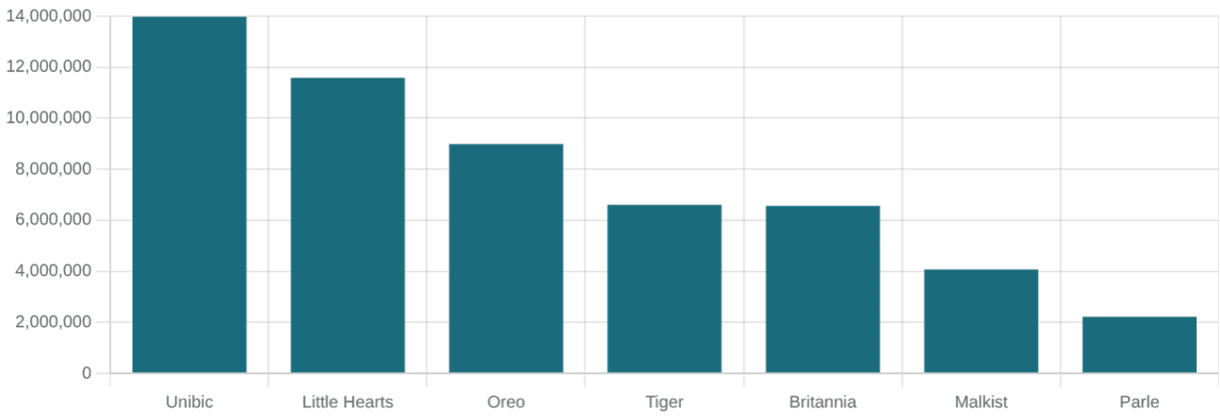
Unibic and Little Hearts Lead Revenue; Unibic Dominates Profit with 78% Margin
$13.9M
78%
321K
$61.6M
TOP BRAND REVENUE (UNIBIC)
HIGHEST PROFIT MARGIN
MAX UNITS (LITTLE HEARTS)
GRAND TOTAL REVENUE
Efficiency Leader
Unibic achieves the highest revenue and highest margin, contributing disproportionately to net income.
Volume Leader
Little Hearts leads in quantity sold (321,645 units), indicating strong market penetration but lower per-unit profitability.
Growth Opportunity
Oreo and Little Hearts share a 50% margin; increasing average order value for these brands could significantly boost profit.
Brand
Revenue By Brand
Profit By Brand
Brand
Profit Margin %
Quantity Sold by Product
Unibic
$13,973,760
$10,868,480
Unibic
78%
310,528
Little Hearts
$11,579,220
$5,789,610
Little Hearts
50%
321,645
Oreo
$8,983,660
$4,491,830
Oreo
50%
320,845
Tiger
$6,606,313
$1,148,924
Sunfeast
40%
297,163
Page 4

Slide 6


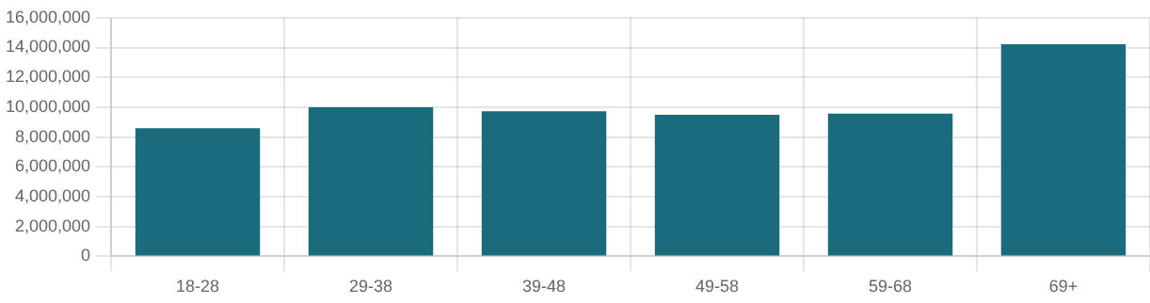
Male Demographics Drive 84% of Revenue; 69+ Age Group is the High-Value Segment
84%
$14.2M
690K
4.8%
MALE REVENUE CONTRIBUTION
REVENUE FROM 69+ GROUP
UNITS SOLD TO 69+ SEGMENT
FEMALE MARKET SHARE
Revenue by Gender
Revenue by Age Group
Gender
Revenue by Gender
% Share
Age Group
Revenue
Unit Sold
Male
$51,966,838
84.4%
18-28
$8,586,611
426,212
Female
$5,844,566
9.5%
49-58
$9,482,226
500,108
Other
$3,756,479
6.1%
69+
$14,213,075
690,924
Strategic Takeaway: The aging demographic (69+) represents the most valuable segment in terms of both volume and revenue. Loyalty programs should prioritize this group while exploring growth tactics for the under-indexed female market.
Page 5

Slide 7

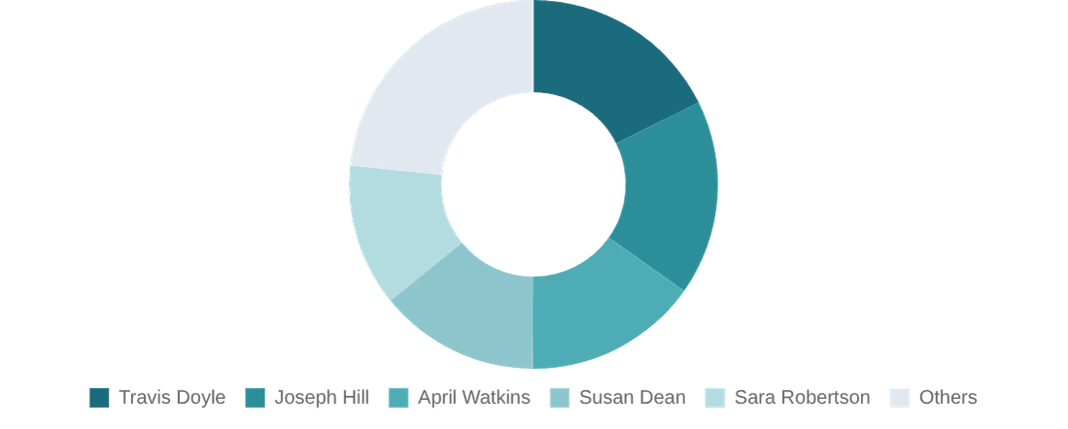
Top 3 Sales Representatives Drive 50%+ of Total Revenue and Profitability
$10.9M
17.7%
$4.8M
Concentrated
TOP REP REVENUE (TRAVIS DOYLE)
TRAVIS DOYLE % CONTRIBUTION
TOP REP PROFIT
PERFORMANCE RISK
Performance by Representative
Revenue Contribution Share
Sales Representative
Total Revenue by Sales Rep
Profit by Sales Rep
%Contribution
Travis Doyle
$10,880,651
$4,777,896
17.67%
Joseph Hill
$10,539,847
$4,629,281
17.12%
April Watkins
$9,402,955
$3,987,214
15.27%
Susan Dean
$8,667,028
$3,812,100
14.08%
Sara Robertson
$7,697,702
$3,368,343
12.50%
Katie Stanton
$6,935,990
$3,071,980
11.27%
Insight: The revenue is highly concentrated. The bottom three reps (Katie, Tracy, Elizabeth) contribute less combined revenue than Travis Doyle alone. Coaching should focus on low-performing tiers to elevate the brand average.
Page 6

Slide 8

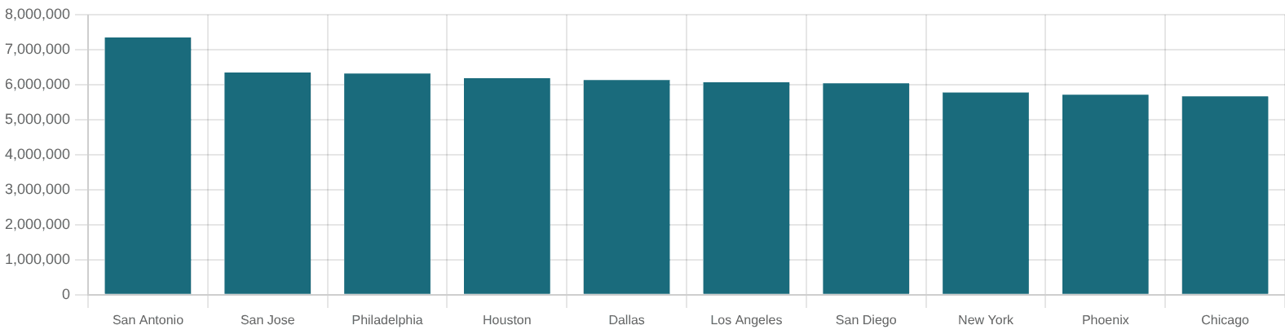
San Antonio is the Clear Leader in Volume and Profit; Houston Requires Margin Focus
$7.34M
45.8%
41.2%
10
TOP MARKET REVENUE (SAN ANTONIO)
SAN ANTONIO PROFIT MARGIN
LOWEST MARGIN (HOUSTON)
ACTIVE MARKET REGIONS
Revenue and Margin by Location
San Antonio is the strongest market overall
: highest revenue ($7.34M), highest quantity sold (345,102), highest profit ($3.37M), and highest margin (45.8%).
Los Angeles is the most efficient large market
: it ranks only 6th in revenue but 2nd in profit margin at 44.5%, indicating strong profitability relative to sales.
Houston needs margin attention
: it ranks 4th in revenue and 4th in quantity, but last in margin at 41.2%. This suggests higher costs or weaker pricing versus other cities.
Location
Revenue by Location
Sum of Profit
%Profit Margin by Location
Rank
San Antonio
$7,343,282
$3,365,775
45.8%
1
Dallas also performs efficiently
Los Angeles
$6,066,717
$2,702,399
44.5%
2
Dallas
$6,128,566
$2,715,580
44.3%
3
: it ranks 5th in revenue but 3rd in margin at 44.3%. Its profit exceeds several higher-revenue locations.
San Jose
$6,343,424
$2,793,480
44.0%
4
Houston
$6,179,951
$2,546,501
41.2%
10
San Jose is high-volume but not the most profitable
: it ranks 2nd in revenue and 3rd in quantity, but only 4th in margin at 44.0%.
Chicago and Phoenix are the weakest margin markets after Houston
, at 42.0% and 42.2%, respectively.
Page 7

Slide 9

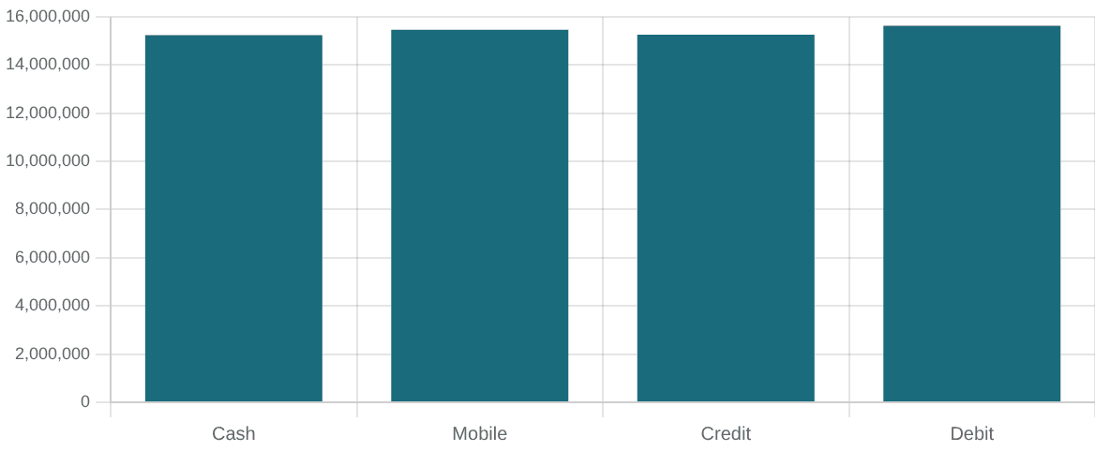
High-Value Buyer Behavior and Payment Mix Inform Retention Strategies
$658K
140
25%
$15.4M
TOP BUYER LIFETIME VALUE
TOP BUYER TRANSACTIONS
MOBILE PAYMENT SHARE
MOBILE REVENUE TOTAL
Top Buyer Spotlight
Payment Method Revenue Mix
Name
Robert Hernandez
Location
Philadelphia
Demographics
Female, Age 69+
Total Revenue
$658,053
Total Units
35,222
"High-volume, repeat purchasers in the 69+ bracket are the primary revenue anchors. Retention of these individuals is critical to baseline stability."
Payment Method
Revenue by Payment Method
Count of Orders
Cash
$15,237,198
2,976
Mobile Payment
$15,461,629
3,038
Credit Card
$15,248,942
2,978
Debit Card
$15,620,114
3,008
Page 8

Slide 10

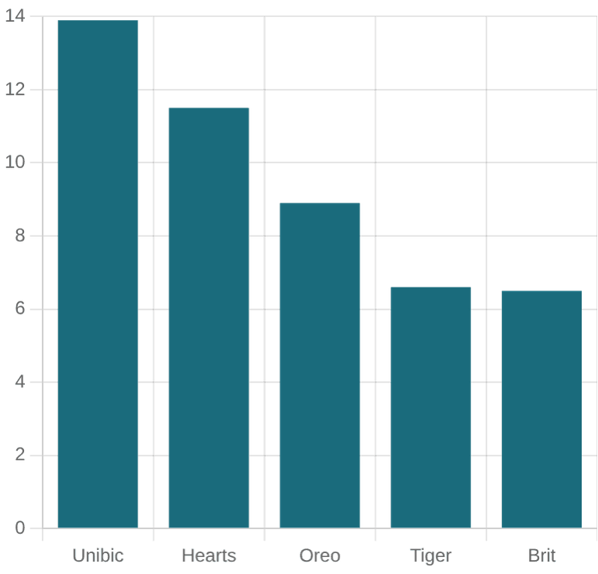
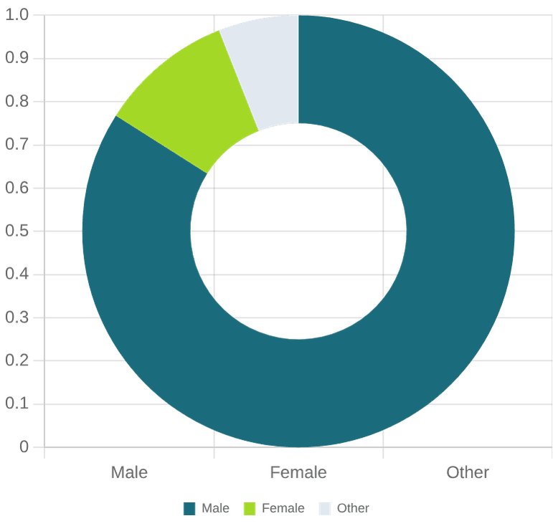
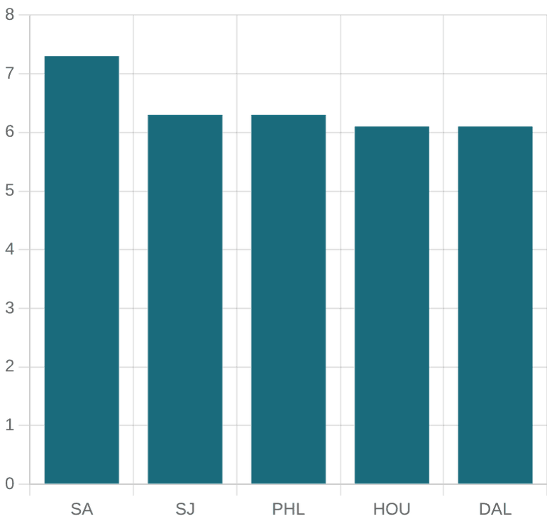
Executive Summary: High-Margin Product Optimization and Territorial Expansion
$61.6M
43.5%
Unibic
San Antonio
TOTAL Q3 REVENUE
AVG PORTFOLIO MARGIN
FLAGSHIP BRAND
GROWTH ANCHOR
Revenue By Brand
Revenue by Gender
Revenue by Location
1. Product Strategy
2. Market Strategy
3. Demographic Strategy
Protect and expand Unibic, the clear leader. Use Little Hearts volume to build profitable bundles and review lower-margin brands.
Protect and expand San Antonio. Study Los Angeles and Dallas for pricing or product mix practices; investigate Houston costs and discounts.
Prioritize the 69+ high-value segment and review payment preferences by Gender and Age Group before launching targeted campaigns.
Page 9

Slide 11
